Slide 1
Enabling Grid Modernization Through Alternative Rates and Alternative Regulation
Presented By
Sanem Sergici
Co-authors
Ahmad Faruqui
William Zarakas
Presented To
Energy Policy Roundtable in the PJM Footprint
November 29, 2018

Slide 2
Agenda
Introduction
Alternative Rates in Maryland
Trends in Grid Modernization Efforts
Alternative Regulation- Why Now?

Slide 3
Rate design is ripe for a change
Problems caused by the volumetric and static rate structures have become too big to ignore
Falling load factors, driven by falling sales and rising peak loads
DERs will continue to exacerbate the mismatch between revenue and costs
Regulatory pressures are mounting
Push for grid modernization, increased DER penetration, greater customer choice, and greater system efficiency
Customer needs are changing rapidly
Seamless integration of technologies with the grid at the same level of reliability they have today
Expect customized and personalized rate options

Slide 4
Behavioral economics tells us that customers have diverse preferences
Market research studies and surveys undertaken in the context of time-based pricing pilots reveal valuable insights on customer preferences
Some want the lowest price
They are willing to be flexible in the manner in which they use electricity
Some want to lock in a guaranteed bill
They are willing to pay a premium for peace-of-mind
Many others are in between these two bookends
Some might want a guaranteed bill but may be willing to lower it if rebates are offered for reducing demand during peak periods
Others may wish to subscribe to a given level of demand
All customers want choice but they only want what they want

Slide 5
Time Varying Pricing in Maryland
2008, BGE initiated Smart Energy Pricing Pilot
Tested customer response to PTR and CPP rates side by side
2009-2012, SEP pilots continued
Tested various forms/levels of PTR, with and without technology
2013, Default PTR program, Smart Energy Rewards, was rolled out
About 80% of customers have earned rebates and saved $40 million since 2013
Tested persistence of impacts
Both BGE and PHI offer peak time rebates of $1.25/kWh to their customers in Maryland (~ 2 million households), and bid in the load reductions into the PJM capacity market
The average peak reduction across SER rebate earning customers has been quite consistent since 2013, ranging from 13.7% in 2013 to 15.3% in 2017

Slide 6
A new TOU pilot will be deployed in Maryland in the Spring of 2019
The two-year TOU pilot is being developed as part of the Maryland PSC’s Public Conference 44 (PC44) effort, and will be executed by BGE, Pepco and Delmarva Power, the “Joint Utilities” of Maryland
The primary objective of the pilot is to determine if TOU rates can help lower customer bills, especially for low to moderate income (“LMI”) customers
The pilot is currently addressing customers taking Standard Offer Service (SOS), however there is also another one under consideration for customers receiving service from a retail supplier
The SOS pilot will feature cost-based TOU SOS rates and TOU delivery service rates

Slide 7
PC44 TOU Pilot Design
 | Summer ( June 1 – September 30) | Non-Summer (October 1 – May 31)
On-peak | 2pm- 7pm on weekdays | 6am- 9am weekdays
Off-peak | All other hours are off-peak, including holidays and weekends | All other hours are off-peak, including holidays and weekends
Example Rates as Listed in Final Work Group Report
Targeted sample size for each utility is 4,020 of which 1,608 will be represented by LMI customers
Sample sizes were determined using statistical power calculations
Notes:
The differential between on-peak and off-peak SOS rates will be generated by taking the default residential SOS rate and moving all transmission and capacity costs into the on-peak period.
The differential between on-peak and off-peak delivery service rates will be generated by taking the default residential delivery service rate and moving all Primary Demand costs into the on-peak
period.

Slide 8
PC44 pilot will advance the state of our TOU knowledge
A few U.S. utilities (SMUD, the City of Forth Collins) have already started to transition their residential customers to default TOU rates and California IOUs are gearing up to do so in 2020
However, there are still a few unsettled questions, which PC44 TOU pilot aims to answer and advance our state of knowledge by:
Testing the impact of TOU on LMI customers on a sufficiently large sample size to yield conclusive results
Applying TOU rates on both the energy and delivery charges with a sizable peak/off-peak ratio and increasing the portion of the bill that is subject to the TOU rate
Understanding customer satisfaction with opt-in TOU rates

Slide 9
Trends in Grid Modernization Efforts
We recently reviewed 21 recent grid modernization initiatives; of which 10 could be reviewed in sufficient detail to reveal trends. This review showed:
Driver
Most grid modernization efforts were initiated in response to local or state policy requirements;
Regulatory Approval
Regulatory approvals were mostly based on standardized benefit-cost tests, such as the Total Resource Cost (TRC) test
Process
Obtaining regulatory approvals took 13 months on average
Cost Recovery
Some were based on utility initiatives
Some received approvals based on break-even analysis; proof of cost prudency and foundational nature of investments for other utility initiatives to move forward
Significant delays were due to incomplete benefit-cost analysis and strong stakeholder oppositions
The majority of utilities go through general rate case filings for cost recovery
However, there are a number of utilities that rely on formula rates and rate riders to address regulatory lag.
Some jurisdictions used PBR and performance incentive mechanisms in combination with the cost recovery of grid modernization investments
(See Sergici et al., “Reviewing the Business Case and Cost Recovery for Grid Modernization Investments: Summary of Recent Methods and Projects,” prepared for NEMA, forthcoming)

Slide 10
Alternative Regulation- Why Now?
Under the traditional utility business / regulatory model:
Growing sales enabled utility to continue capital investment while keeping rates in check
Utility earnings were facilitated by necessary growth in rate base
This model is not sustainable in many jurisdictions as the foundational pillars of the model have been dissolving:
Sales growth rate has slowed (or reversed)
Aging assets and calls for grid modernization lead to increasing costs
Productivity growth is relatively flat
Industry participants are not satisfied with results
Utilities: Declining sales + regulatory lag = under-earnings
Customers: Looking for alternative ways to deal with cost pressures, beginning to voice interest in choice and alternative providers of some energy services
Notes:
Some applications have been in use for a while – depending how wide we define PBR
Price cap plans were applied in telecom in mid 1980s
Formula rates (maybe not PBR per se) have been in use in the electric utility industry since 1982
Multi-year rate plans have become common practice, sometimes as a result of practical administrative reasons

Slide 11
Alternative Regulation- Why Now? (cont’d)
Regulators/policymakers:
Need for rate increases raises concerns about (lack of motivation for) control on costs and capital spending; exacerbated by grid modernization efforts
Evolving goals may require utilities to provide access to the (physical or virtual) grid
Concerns about resilience (in a world of more frequent extreme events)
These recent changes in the industry environment have prompted many regulators to call for more proactive investigation of PBR options
E.g., NY, Michigan, Hawaii and only recently Ohio and Pennsylvania
Notes:
Some applications have been in use for a while – depending how wide we define PBR
Price cap plans were applied in telecom in mid 1980s
Formula rates (maybe not PBR per se) have been in use in the electric utility industry since 1982
Multi-year rate plans have become common practice, sometimes as a result of practical administrative reasons

Slide 12
PBR in Perspective
PBR (or incentive regulation) refers to a regulatory mechanism that creates a stronger connection between utility performance (e.g., cost, operations, policy goals) and earnings
Goal | Incentive Area | Mechanism
1) Cost/Price Control | Overall financial performance | Broad-based Incentive Frameworks Multi-year Rate Plans (MRPs) (e.g., price caps, RPI-X)
2) Targeted Performance or Policy Goals | “Traditional” operational areas (e.g., SAIDI) “Emerging” performance targets (e.g., increased EE, decreased DER interconnection time, etc.) | Narrower Incentive Mechanisms Performance Incentive Metrics (PIMs)
3) Investment Incentives (e.g., Grid Modernization, Reliability, Resilience) | Risk Reduction | Supplemental Incentives (e.g., Capex Riders, formula rates)
Notes:
Most utilities are enthusiastic about undertaking grid modernization projects, provided they are granted timely cost recovery. Traditional general rate case approach can result in significant regulatory lag and associated uncertainties
This has prompted some jurisdictions to revisit their existing regulatory models and consider alternative regulatory models, such as “performance-based regulation”, a regulatory mechanism that creates a stronger connection between utility performance (e.g., cost, operations, policy goals) and earnings

Slide 13
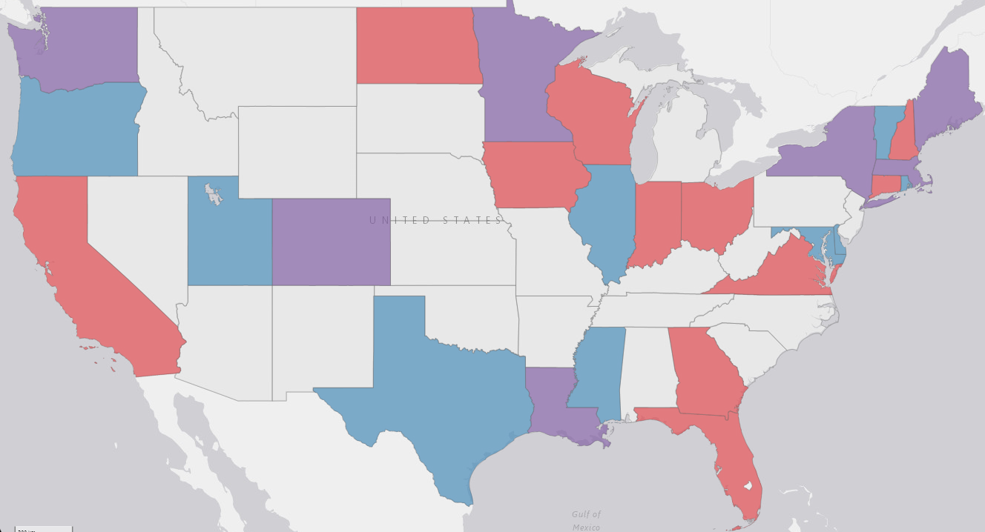
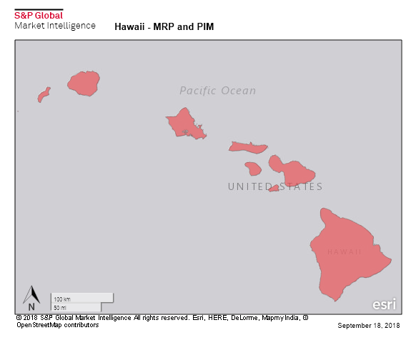
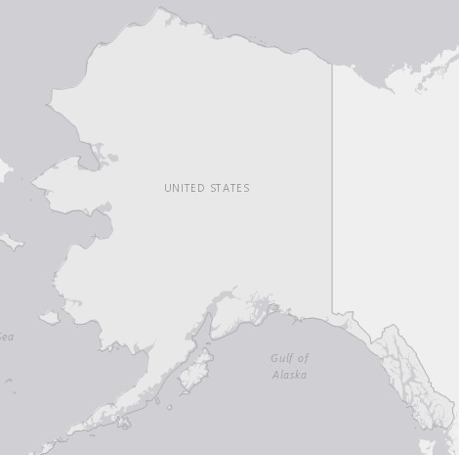
PBR In Perspective (cont’d)
Has been in use for some time; relatively widely applied in the U.S. and abroad
Builds on incentive structures used in traditional rate of return regulatory methodology
Some renewed attention as a result of changes in the industry environment, interest in advancing policy goals and keeping customer rates affordable
This trend is expected to continue as the urgency of grid modernization investments increase
PBR in the U.S.
States with MRPs only
States with PIMs only
States with MRPs and PIMs
Other states

Slide 14
PBR In Practice
PBR plans are actually composed of traditional rate of return regulation with one or more PBR-type mechanisms added on
Regulatory Framework = Traditional RoR + Combinations of PBR Elements

Slide 15
Benefits/Motivations for PBR
Customers, utilities and policymakers have overlapping motivations for and potential benefits from PBR
Customers
Enable Distributed Resources
Less Frequent Rate Cases
Performance Standards
Improve/Maintain Customer Satisfaction
Rate
Predictability
Improve /Maintain
System
Reliability
Stable Rates
Develop Resilient and Secure Systems
Cost Control
Implement Renewable Energy & GHG Goals
Incentives for Innovation
Opportunity to Align Financial Goals with Performance
Development of New Business Models
Utilities
Policymakers

Slide 16
Presenter Information
Sanem Sergici, Ph.D.
Principal│ Boston, MA
Sanem.Sergici@brattle.com
+1.617.864.7900
Dr. Sanem Sergici is a Principal in The Brattle Group’s Boston, MA office specializing in program design, evaluation, and big data analytics in the areas of energy efficiency, demand response, smart grid and innovative pricing. She regularly supports electric utilities, regulators, law firms, and technology firms in their strategic and regulatory questions related to retail rate design and grid modernization investments.
Dr. Sergici has been at the forefront of the design and impact analysis of innovative retail pricing, enabling technology, and behavior-based energy efficiency pilots and programs in North America. She has led numerous studies in these areas that were instrumental in regulatory approvals of Advanced Metering Infrastructure (AMI) investments and smart rate offerings for electricity customers. She also has significant expertise in development of load forecasting models; ratemaking for electric utilities; and energy litigation. Most recently, in the context of the New York Reforming the Energy Vision (NYREV) Initiative, Dr. Sergici studied the incentives required for and the impacts of incorporating large quantities of Distributed Energy Resources (DERs) including energy efficiency, demand response, and solar PVs in New York.
Dr. Sergici is a frequent presenter on the economic analysis of DERs and regularly publishes in academic and industry journals. She received her Ph.D. in Applied Economics from Northeastern University in the fields of applied econometrics and industrial organization. She received her M.A. in Economics from Northeastern University, and B.S. in Economics from Middle East Technical University (METU), Ankara, Turkey.
The views expressed in this presentation are strictly those of the presenter(s) and do not necessarily state or reflect the views of The Brattle Group, Inc.

